Slide 1

EVALUATION OF PHOTON INTERACTION CROSS-SECTION AND RADIATION TRANSMISSION CHARACTERISTICS OF TUNGSTEN AND TITANIUM DOPED TELLURITE GLASS
A Term Paper
Submitted to
Central Department Of Physics
Advisor
Dr.Tika Ram Lamichhane
Associate Professor
CDP,TU
By
Santosh Poudel
Roll.No:3539/07
December,2022

Slide 2
Introduction/
Motivation/Reason For the Research
1.
Research Objectives
2.
Table of Contents
3.
Literature Review
4.
Methodology
5.
Results and Discussions
6.
Conclusions

Slide 3
1. Introduction
Radiation is the general term for the emission of energy as waves or particles. Both in the presence of the medium and its absence, it occurs.
Radiation comes in a wide variety of forms, such as electromagnetic, particle, acoustic, and gravitational radiation. Electromagnetic radiation, in addition to radio waves and microwaves, also includes visible light, ultraviolet, x-rays, and gamma radiation.
. Alpha, beta, proton, and neutron radiation are the four different forms of particle radiation.
Radiation can also be classified as ionizing and non-ionizing depending on the energy of the particles that are emitted.
In this research we studied the transmission characteristics of three main types of ionizing radiation that are alpha, beta and gamma radiation.

Slide 4
Motivation/
Reason for this research
Shortly aftet the discovery of x-rays radiation shielding equipment were develop to prevent from the risk of radiation exposure. Lead glass was frequently used in these early efforts to absorb radiation
Lead has been utilized as a radiation-shielding material in a variety of settings, including nuclear and industrial shielding, radiation therapy, and diagnostic imaging. Because of its high density, atomic number,linear and mass attenuation coefficients, lead is one of the radiation shielding materials that is frequently employed for protection against radiation .
When lead or items contaminated with lead are ingested or inhaled, they can pose a risk to health. They are considered very harmful.
Therefore, it is vitally important to investigate compositions without lead.
Because of their exceptional nonlinear optical properties, tellurite-based glasses are thought to be attractive materials for a number of applications.

Slide 5
What we are going to do in this Research?
In the aim to find lead free glasses we will take and examine the composition of three metal oxides namely Tellurium dioxide(TeO2), Titanium Dioxide(TiO2) and Tungsten Dioxide(WO3))
They will be taken with the chemical composition of (85-x)TeO2-15TiO2-xWO3 (where x = 0, 6, 12, 18 and 24 mol%)
We will examine whether or not they are the best composition for radiation shielding applications

Slide 6
2. Research Objectives
To research and evaluate various radiation transmission and shielding characteristics of Te-Ti-W oxides using an online softwre/database PHY-X/PSD and Xcom.
To assess the suitability of the researched sample for the specified purpose.

Slide 7
3. Literature Review
In 1997 S.Kobayashi N.Hosoda R.Takashima studied the shielding properties of tungsten based alloys.
They discovered that alloys made of tungsten and tungsten-copper were useful for radiation shielding. Compared to the recently used lead, these materials performed better. The radiation-shielding of dispenser bottles or vials for high-level radiochemicals should be done using tungsten alloys.
In 2020, M S Al-Buriahi and et.al investigated the fundamental parameters and radiation-shielding characteristics of glasses made of (100x)TeO2+xZnO+4NiO. They found that the mechanical characteristics and radiation shielding capability of the TZN-X glasses were significantly influenced by the concentration of ZnO material.
In 2021, Ilyas Çaglar and et.al studied the Properties of various binary Tellurite Glasses for Gamma Radiation shielding. They found that the tellurite glasses that were doped with WO3 exhibited better gamma-ray absorbing behavior than other glass systems, and as the concentration of WO3 grows, so does the glasses' capacity to do so.

Slide 8
4. Methodology
The online tool Phy-X/PSD is used to conduct this research. A user-friendly online Photon Shielding and Dosimetry (PSD) tool has been created and is available at https://phy-x.net/PSD for the computation of shielding and dosimetry-related parameters.
Academic email addresses are required for registration process verification. After logging in, the initial action is to properly characterize the material's constitution for use in computations.
The software supports both mole fraction and weight fraction as two ways to enter the material composition. To add more content, the plus (+) sign must be placed between the elements, as in 60WO3+30TiO2+10V2O5. The energy range must be chosen after the composition of the components has been organized. There are two avalilable options: selected and standard grids. The selected energy grid ranges from 15KeV to 15MeV . After energy range selection , the software allows us to select the parameters that are to be calculated. The Parameters that we are going to select are: MAC, LAC, MFP, HVL, TVL, Zef f . The obtained data after calculation can be saved as an excel file.

Slide 9
5. Result and Discussions
The samples used and their density are tabulated below:
Sample | Density(gm/cm³)
86TeO2+15TiO2+0WO3 | 5.39453
79TeO2+15TiO2+6WO3 | 5.44539
73TeO2+15TiO2+12WO3 | 5.52582
67TeO2+15TiO2+18WO3 61TeO2+15TiO2+0WO3 | 5.9389 5.66366
Table 1: Samples and density

Slide 10
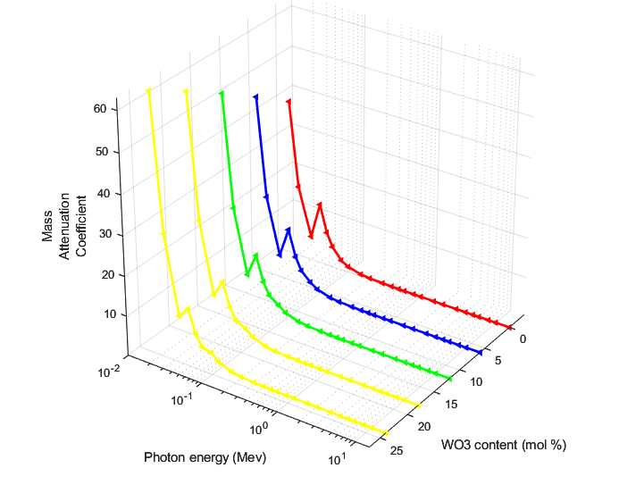
5.1 Mass Attenuation Coefficient
Fig: MAC as a function of photon energy and WO3 content

Slide 11
The Mass attenuation Coefficient (µ/ρ), expresses the cross section per unit of mass for the photon interaction with the sample glasses..
According to the photon energy, the cross section is governed by the main mechanisms (photoelectric effect, pair-production and Compton scattering).
For example, the photoelectric effect dominates in the low energy regions and one can see dramatic decrease in the µ/ρ values of sample glasses as shown in Fig. 4.2. Therefore, the maximum values of µ/ρ occurred at 0.015 MeV and were 39.444, 45.853, 51.907, 57.634, and 63.060 cm2 /g for first, second, third, fourth, and fifth sample respectively
Also, there is no remarkable difference between the behaviour of µ/ρ (especially in the moderate energies) for the five glass samples (1→5). This is due to that the five glasses sample have the same chemical composition regardless of the difference in their concentrations. Such difference increases the density and then the shielding effectiveness of the chosen sample glasses.
More specifically, the µ/ρ values of TTW glasses increases from 39.444 to 63.060 cm2 /g as the WO3 content increases from 0 to 24 mol%. Moreover, the curves of µ/ρ for sample glasses experience a sudden change around the K-absorption edge of Titanium dioxide due to the photoelectric effect when the energy of the incident photon is equal to the binding energy of the electron.

Slide 12
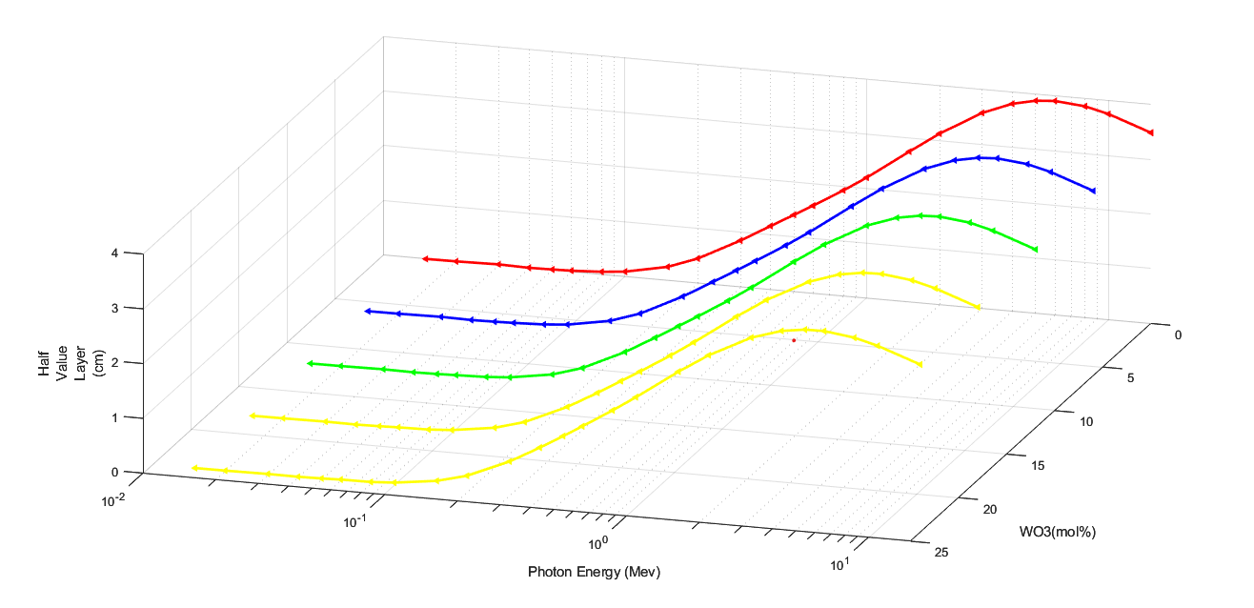
5.2 Half Value Layer
fig2: HVL as a function of photon energy and WO3 content

Slide 13
Half Value Layer
The HVL is an important estimator to understand the gamma transmission through matter.
The smallest values of HVL reflect more attenuation for gamma photons in matter and this is more preferable and economic to design new shields for radiation applications.
It is seen that the HVL is minimum(i.e exactly 0) at 0.015MeV photon energy and then increases with increases with increase in photon energy for all four samples. HVL gets maximum at a certain energy and then decreases slightly upto 15 MeV for all four samples.
The lower value of HVL is seen nearly zero for all samples. But among the highest values of HVL, smaller one is of the sample which has tungnsten dioxide concentration High . It is due to the larger density of tungsten trioxide.

Slide 14
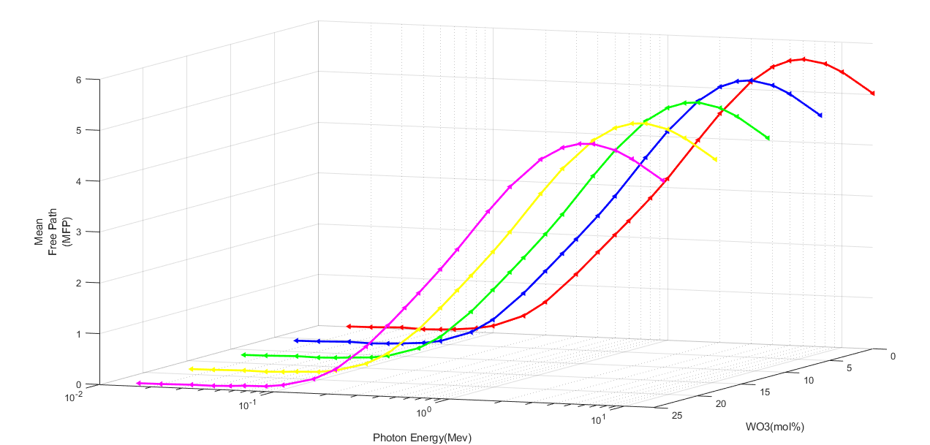
5.3 Mean free path
Fig.MFP as a function of Photon E.
Fig3: MFP as a function of Photon Energy for different Compositions

Slide 15
Mean free path
The MFP is another important estimator to understand the gamma transmission through matter.
Just as HVL MFP have to be low as much as possible for better shielding capabilities

Slide 16
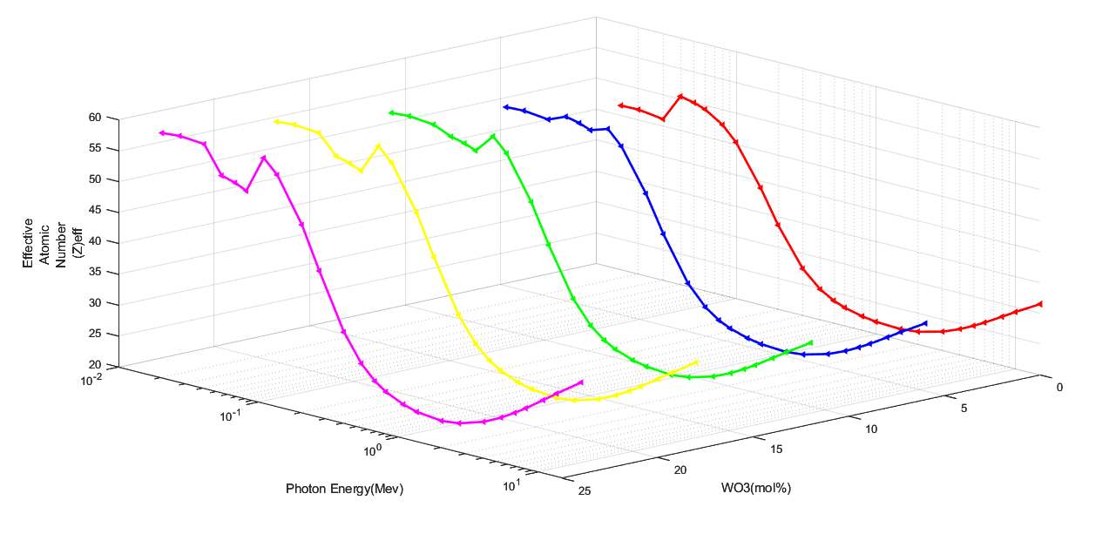
5.4 Effective Atomic Number
Fig. Zeff as the function of photon energy and WO3 mol % content

Slide 17
Effective Atomic Number
In nuclear physics and material science, effective atomic number (Zeff) is regarded as an energy dependence parameter that can describe the partial photon interactions in different energy regions. It should be noted that the Zeff of matter is totally different of mean atomic number 〈Z〉.
For every given material, this parameter can be used to explain the attenuation of gamma photons, electrons, proton, and alpha radiations and the high values of this parameter reflect more attenuation of gamma photons.
In practical application, when a glass sample has a high Zeff-G, this means reliable gamma shielding.
Higher values of effective charge number are seen for compositions with higher concentration of Tungsten trioxide whereas lower values of effective charge number are seen for alloy with lower concentration of Tungsten trioxide and higher concentration of tellurium dioxide.

Slide 18
6.Conclusions
It was discovered that these compositions of tellurite dioxide, titanium dioxide, and tungsten dioxide are suitable for radiation shielding by examining a wide range of features, including LAC, MAC, MFP, and HVL. The HVL value, which is a reliable indicator of gamma ray transmission through matter, was determined to be good.
The results showed that regardless of the concentration of TiO2 in the glass sample, an addition of WO3 has a positive influence on density, and as a result, in the shielding capability of the glass against gamma and beta radiation. This influence, however, is much stronger in the case of the shielding against gamma radiation.
When compared to various typical concretes, commercial glass, and HMO glasses, it was discovered that it is a better gamma-ray shielding material. Application of the results of the current study on the shielding characteristics of the chosen tellurite-based glasses might benefit radiation protection.

Slide 19
Acknowledgements
I would like to express my sincere gratitude to Associate Prof. Dr. Tika Ram Lamichhane, Central Department of Physics, Tribhuvan University for his guidance during my work as my advisor.
I gratefully acknowledge Prof. Dr. Om Prakash Niraula, Head, Central Department of Physics, Tribhuvan University for his valuable suggestions, inspiration for being the supportive system. I also thank the teaching faculty for regular inspiration and non teaching staffs of department for their support in this work.
Last but not the least, I express my gratitude to my family for their support and encouragement in research activities.

